Slide 1


Sales Analysis Report
Complete By: Adam Roberts

Slide 2
Report TOC
1
2
3
Overall Revenue
Customer Analysis
Product Analysis
Rolling Quarter Timeseries
YOY Change
Overall Revenue
YOY Change
Product Counts
Monthly Customer Spend
Company Highlights
Overall Revenue
YOY Change
Product Counts
Video Format Analysis

Slide 3
Revenue Summary

Slide 4
Total Sales
Trailing Quarter
Sales Performance
The overall average revenue for a rolling 3 month period is 1.75M in 2018 – 2019.
Growth was at nearly 100% YOY by trailing quarter up until 2019 where it starts to go to 10-20%.
There is a sharp decline in revenue in September 2019, hopefully due to a partial month of data.
YOY Total Sales Change
Trailing Quarter Compared to Same Quarter Prior Year
YOY Percent Sales Change
Trailing Quarter Compared to Same Quarter Prior Year

Slide 5
Customer Analysis

Slide 6
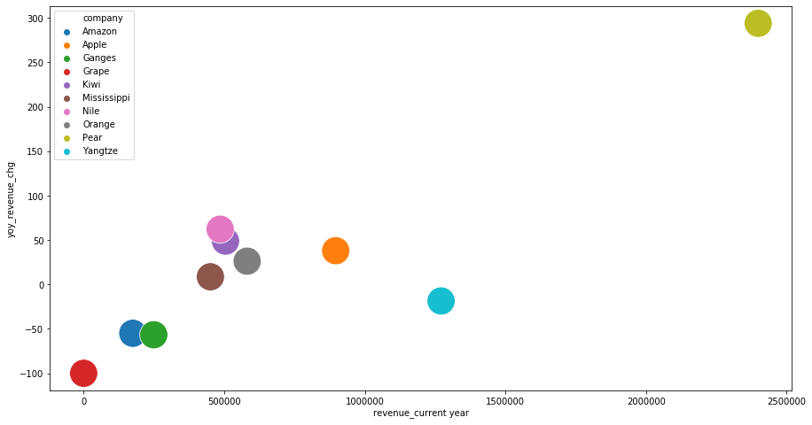
Customer Revenue
Total Revenue vs YOY Change
Trailing 24 Months
Pear has the had the highest revenue in the last 12 months, and the largest amount of growth.
Grape has had $0 in revenue from Oct 2018 - Sept 2019 and has declined 100% as a dropped customer.
YOY Percent Revenue Change
Total Revenue Last 12 Months (Oct 2018 - Sept 2019)

Slide 7
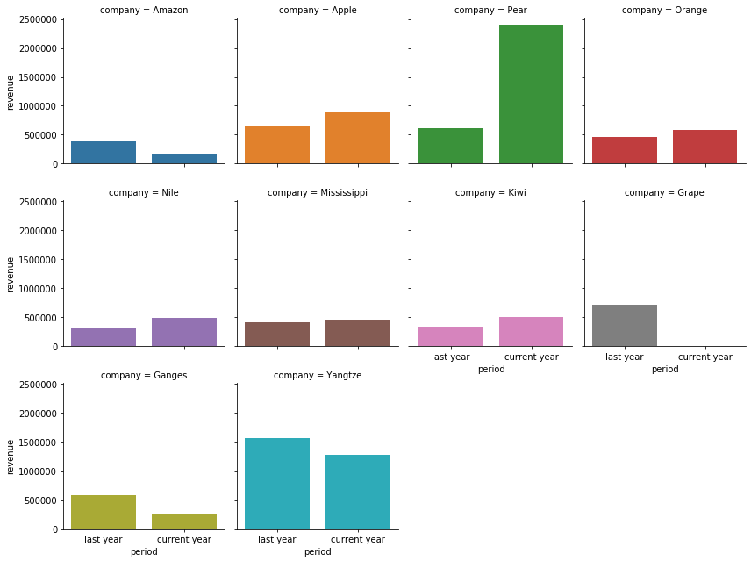
YOY Customer Revenue
Total Revenue YOY
LY: Oct 2017 - Sept 2018 compared to CY: Oct 2018 - Sept 2019
Yangtze may be a customer to watch. While it is the 2nd largest company in revenue, it has had year over year decline.

Slide 8
Customers Product Count
Company | Product Count
 | Last Year Oct 2017 - Sept 2018 | Current Year Oct 2018 - Sept 2019 | YOY Change
Amazon | 4 | 3 | -1
Apple | 1 | 1 | 0
Ganges | 3 | 3 | 0
Grape | 1 | 0 | -1
Kiwi | 3 | 4 | +1
Mississippi | 4 | 3 | -1
Nile | 1 | 1 | 0
Orange | 4 | 4 | 0
Pear | 1 | 1 | 0
Yangtze | 1 | 1 | 0
Year over year growth was not driven by customers adding existing products. Only one customer—Kiwi—grew in terms of number of products purchased.

Slide 9
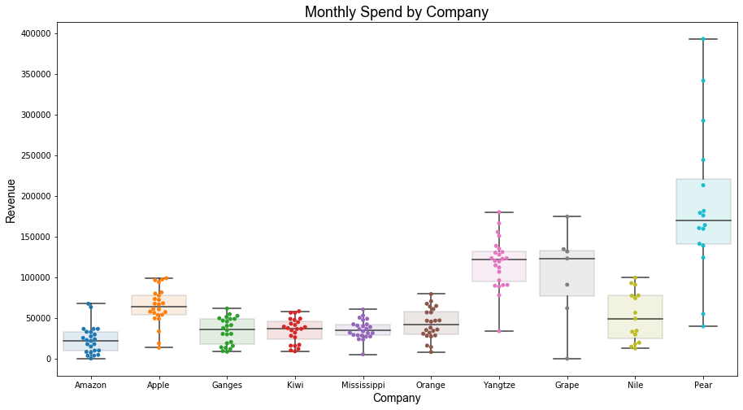
Monthly Customer Spend
Monthly Spend by Customer
Two Year Period: Oct 2017 - Sept 2019
Each dot on the graph represents a companies spend for an individual month over the past 24 months.
Pear, Grape, and Yangtze all have wide ranges of revenue per month.

Slide 10
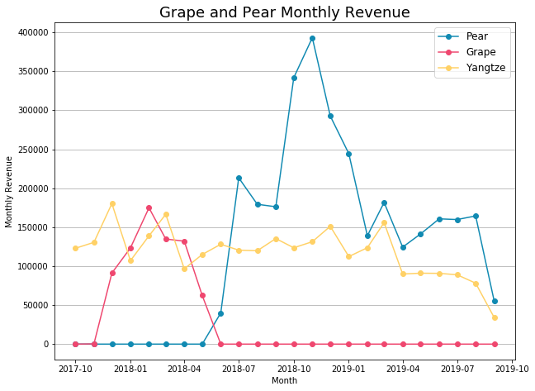
Customer Highlights
Grape and Pear both contributed to the year over year decline in early 2019.
Grape discontinued purchases in June 2018.
Pear was lapping a year where it had higher monthly revenue.
Yangtze has had a moderate month over month decline in revenue.
Total Revenue by Month
Oct 2017 - Sept 2019

Slide 11
Product Analysis

Slide 12
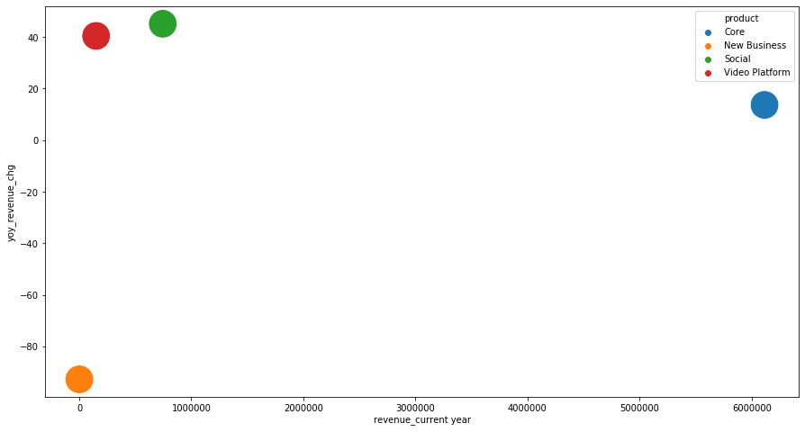
Product Revenue
Total Revenue vs YOY Change
Trailing 24 Months
While smaller in revenue compared to core, social and video platform both have significant growth up 45% and 40% respectively.
6.1M Revenue
13.7% Growth
YOY Percent Revenue Change
Total Revenue Last 12 Months (Oct 2018 - Sept 2019)

Slide 13
Product Customer Count
While social and video platforms have growth significantly in revenue, it is not due to them adding to their total customer counts.
Company | Customer Count
 | Last Year Oct 2017 - Sept 2018 | Current Year Oct 2018 - Sept 2019 | YOY Change
Core | 10 | 9 | -1
New Business | 3 | 1 | -2
Social | 5 | 5 | 0
Video Platform | 5 | 5 | 0

Slide 14
Video Format Revenue
Share of revenue by video format has been higher in the most recent quarter.
Revenue Share by Format
Oct 2017 - Sept 2019

Slide 15

Thank You!
Adam Roberts
email:
adamjamesroberts@gmail.com
phone:
513.403.6811
website:
https://admiral810.github.io/

